Slide 1
Trading During Covid-19
Final Project

Slide 2
Content
INTRODUCTION
DATA COLLECTION
EXPLORATORY DATA ANALYSIS
DATA VISUALIZATION
CONFIDENT INTERVAL
HYPOTHESIS TESTING
CORRECLATION AND REGRESSION ANALYSIS
CONCLUSION
DEMO

Slide 3
Introduction
Dataset explain us about information of trading import and export of products between countries.
Will study about impact of value of trading with Cumulative and Year.
we also find the relationship between some variable in Dataset

Slide 4
Data Collection
SOURCE
This dataset help us to understand about effect of COVID-19 on trade in New Zealand’s daily goods trade with the world.
URL : https://www.stats.govt.nz/assets/Uploads/Effects-of-COVID-19-on-trade/Effects-of-COVID-19-on-trade-At-15-December-2021-provisional/Download-data/effects-of-covid-19-on-trade-at-15-december-2021-provisional.csv

Slide 5
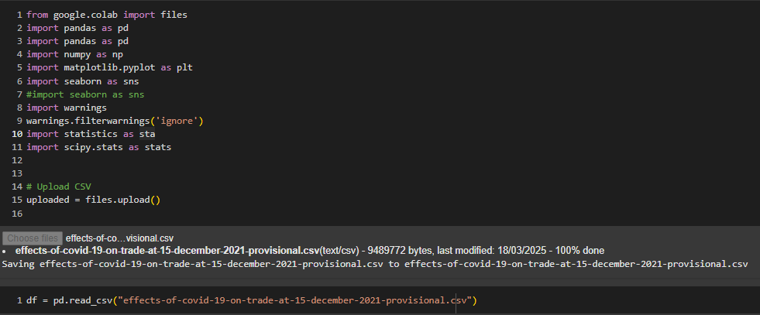
Data Collection
DATA LOADING

Slide 6
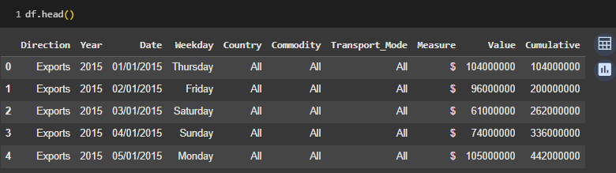
Data Collection
DATA LOADING

Slide 7
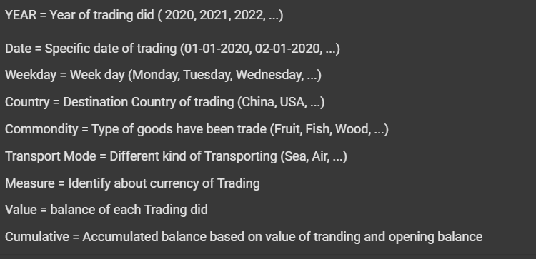
Data Collection
DATA UNDERSTANDING

Slide 8
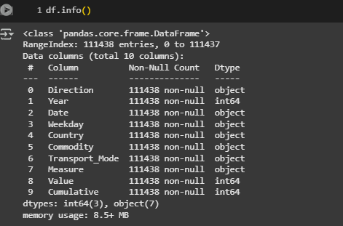
Data Collection
DATA COLUMN

Slide 9
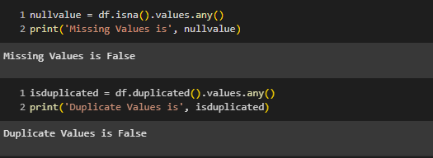
Data Collection
CLEAN VALUE

Slide 10
Exploratory Data Analysis
Analysis on main characteristic of dataset
Make understanding of dataset easier
Help us to know any error, pattern or data outliers.

Slide 11
Exploratory Data Analysis
A. Standard Deviation

Slide 12
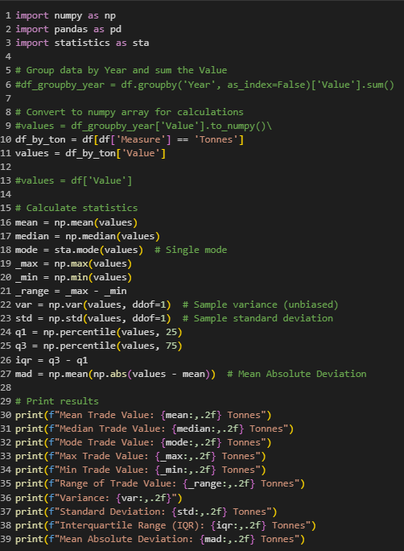
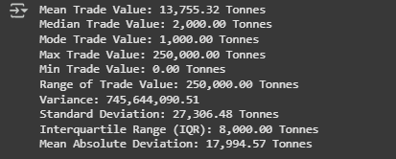

Slide 13
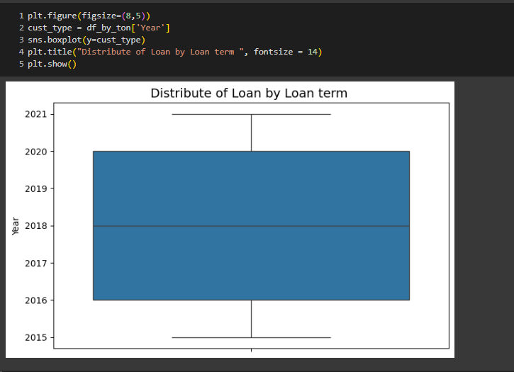
Exploratory Data Analysis
B. Data Outlier

Slide 14
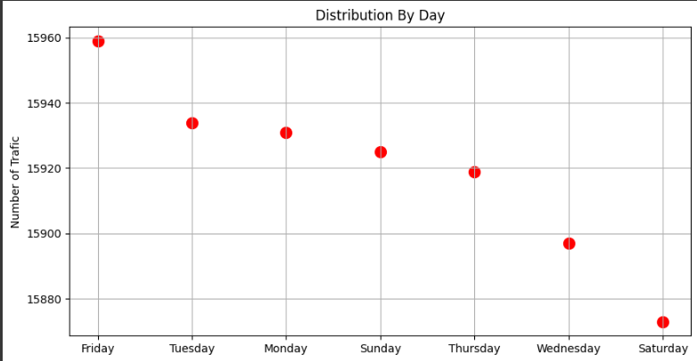
Data Visualization
A. Scatter Chat

Slide 15
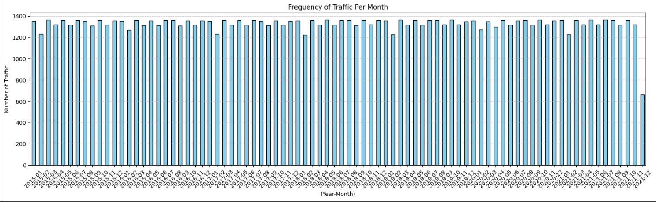
Data Visualization
A. Bar Plot

Slide 16
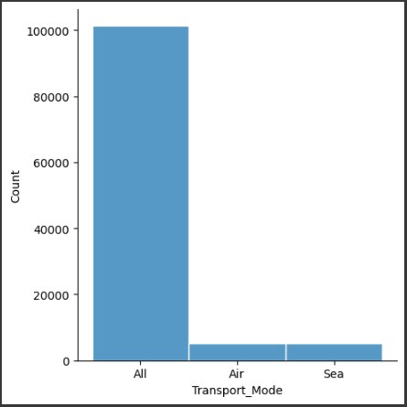
Data Visualization
A. Distribute Plot

Slide 17
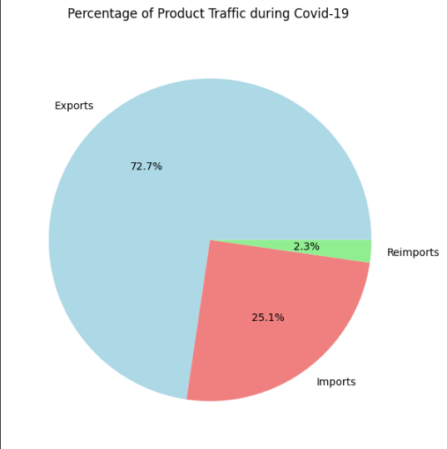
Data Visualization
A. Pie Chart

Slide 18
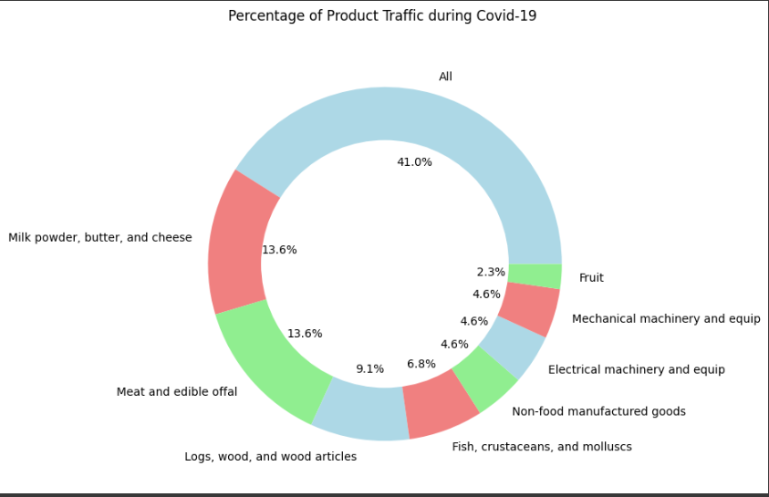
Data Visualization
A. Donut Chart

Slide 19
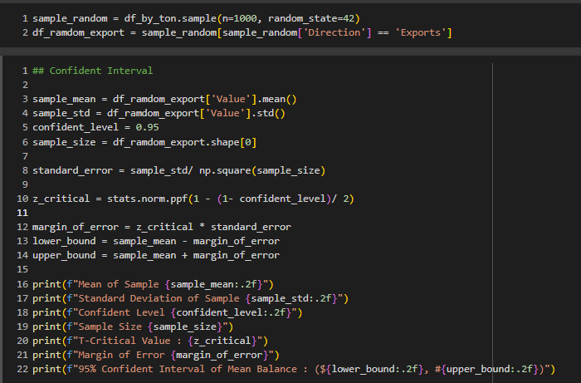
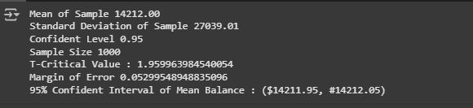
Confident interval

Slide 20
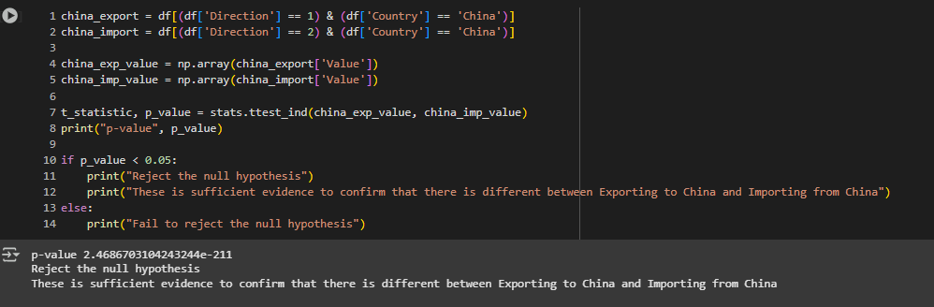
Hypothesis Testing
We test what the means of two independent sample are significantly different.
Interpretation (Average value between Import and Export with China)

Slide 21
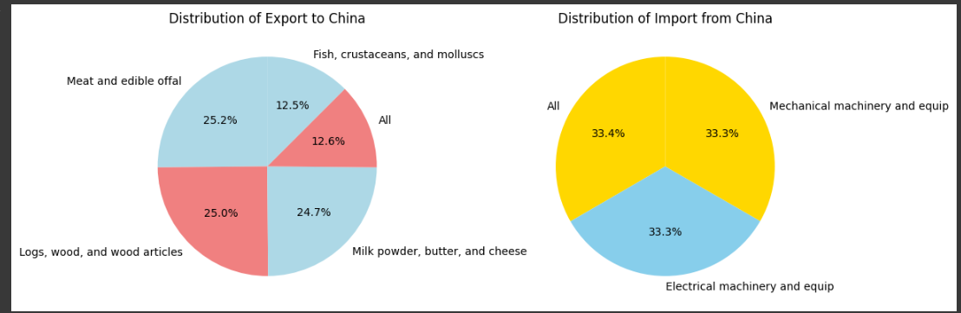
Hypothesis Testing

Slide 22
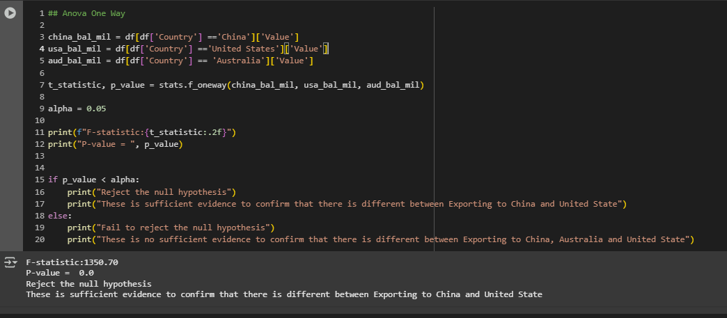
Hypothesis Testing
ANOVA

Slide 23
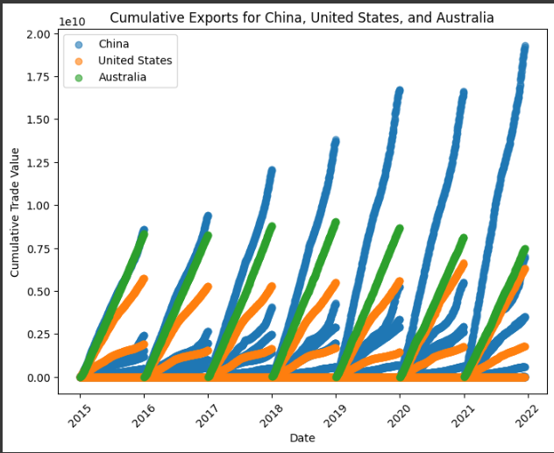
Hypothesis Testing
ANOVA

Slide 24
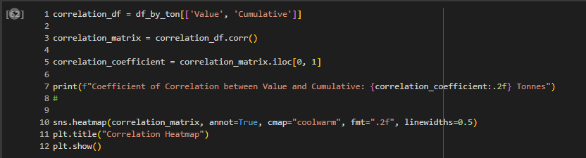
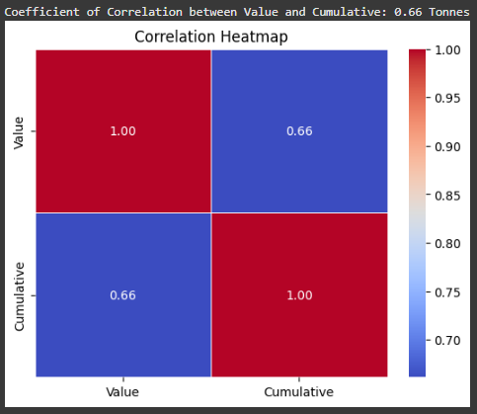
Correlation

Slide 25
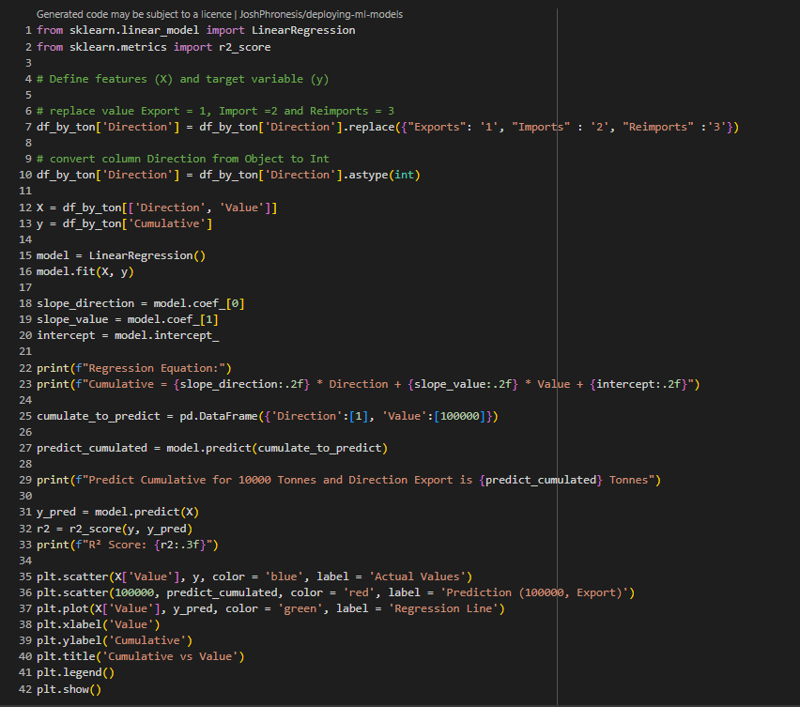
Correlation

Slide 26

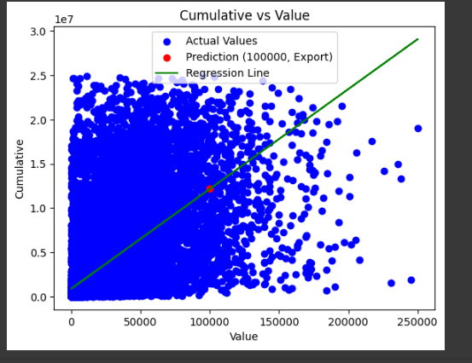
Correlation

Slide 27
Conclusion
Based on information above even during COVID-19 but trading between target country still go properly.
Both government should find more to increase amount cumulative for the future
Make some rule related to Trading to protect some problem happened.

Slide 28
Demonstration

